Slide 1

Introduction to Types of Computers
Overview of computers
Classification of computers based on size, performance, and functionality
Presentation By:
Abdul Basit
&
Abdul Rehman

Slide 2
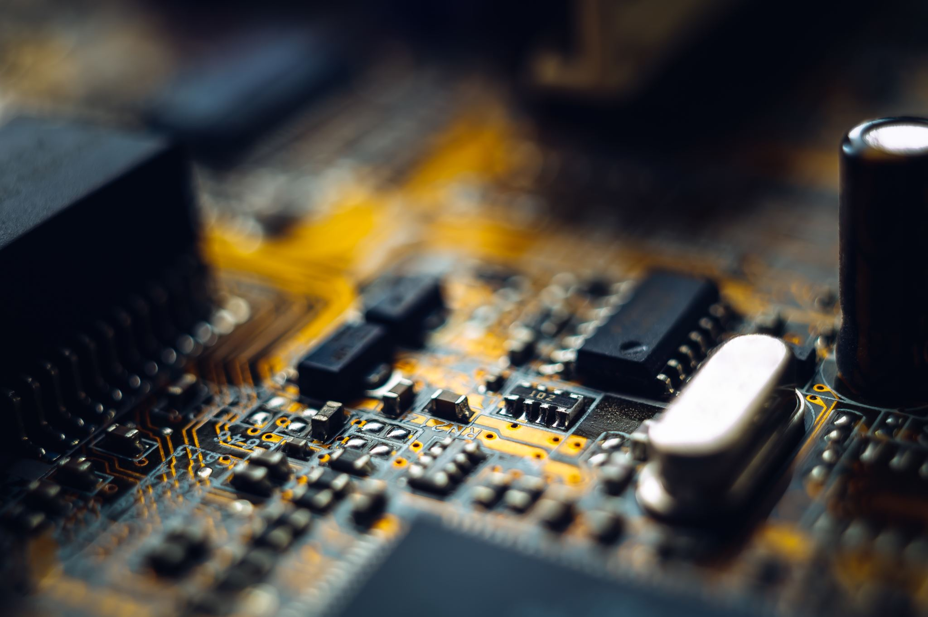

What is a Computer?
A machine that processes data based on a set of instructions or programs.
Performs tasks like calculations, data storage, and communication.
Central to modern life in homes, businesses, and industries.

Slide 3


General-Purpose Computers
Designed to perform a wide variety of tasks.
Examples include personal computers and mobiles.
Can run different types of software for various applications.

Slide 4
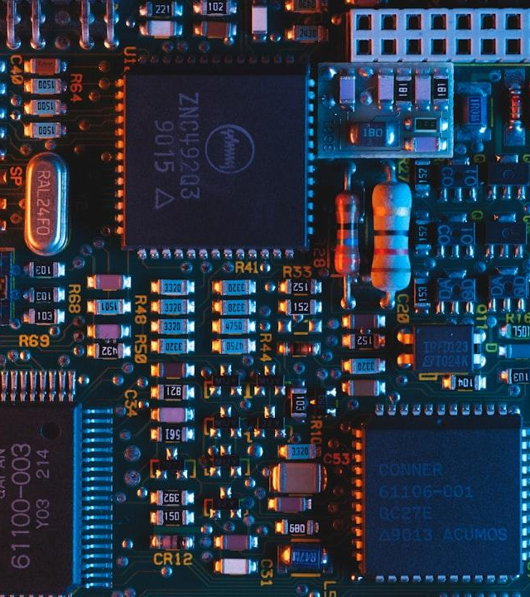

Personal Computers
Desktop and laptop computers
Used for personal tasks, gaming, and work
Examples: Windows PCs, MacBooks, Chromebooks

Slide 5




Handheld Devices
Touchscreen interfaces
Portability and battery life
Communication
Entertainment
Productivity
Examples: Smartphones, Tablets, Wearable technology (smartwatches)

Slide 6
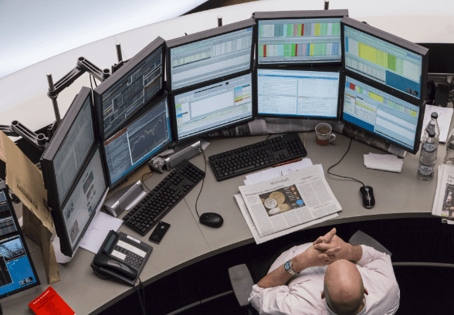

Workstations
High-performance computers for technical or scientific applications
Used by engineers, architects, and designers
More powerful than standard PCs

Slide 7
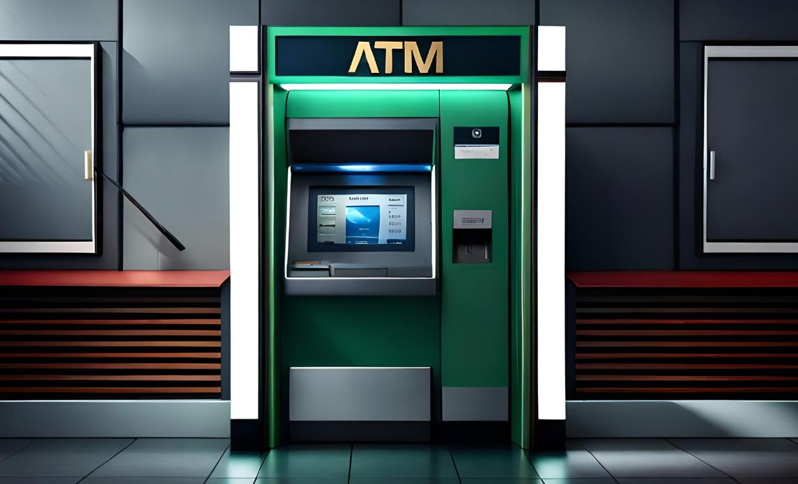

Special-Purpose Computers
Built for specific tasks or operations.
Examples include ATMs, embedded systems in cars, and gaming consoles.
Highly optimized for the function they are intended to perform.

Slide 8


Mainframe Computers
Large, powerful systems for handling vast amounts of data
Used by governments and large corporations
Focus on reliability, stability, and large-scale transaction processing

Slide 9
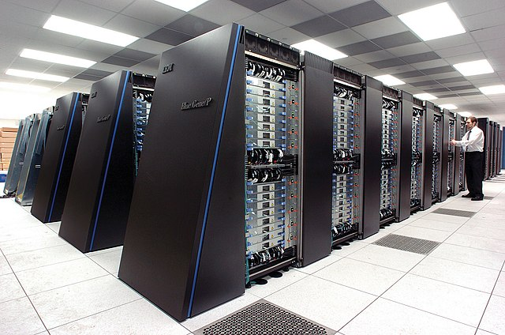

Supercomputers
Fastest and most powerful computers
Used for scientific simulations, weather forecasting, and research
Example: IBM's Summit, Fujitsu's Fugaku

Slide 10
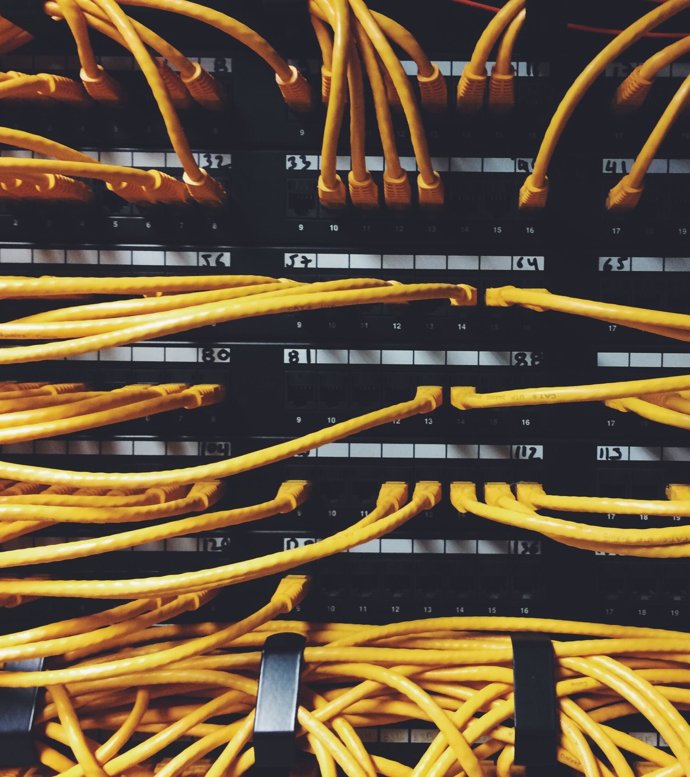

Servers
Provide services to other systems over a network
Used in web hosting, cloud computing, and data storage
Examples: Web servers, database servers

Slide 11
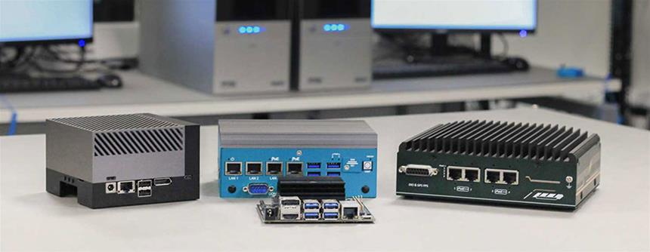

Embedded Systems
Computers embedded in other devices to control specific functions
Found in devices like cars, home appliances, medical equipment
Example: Microcontrollers in IoT devices

Slide 12
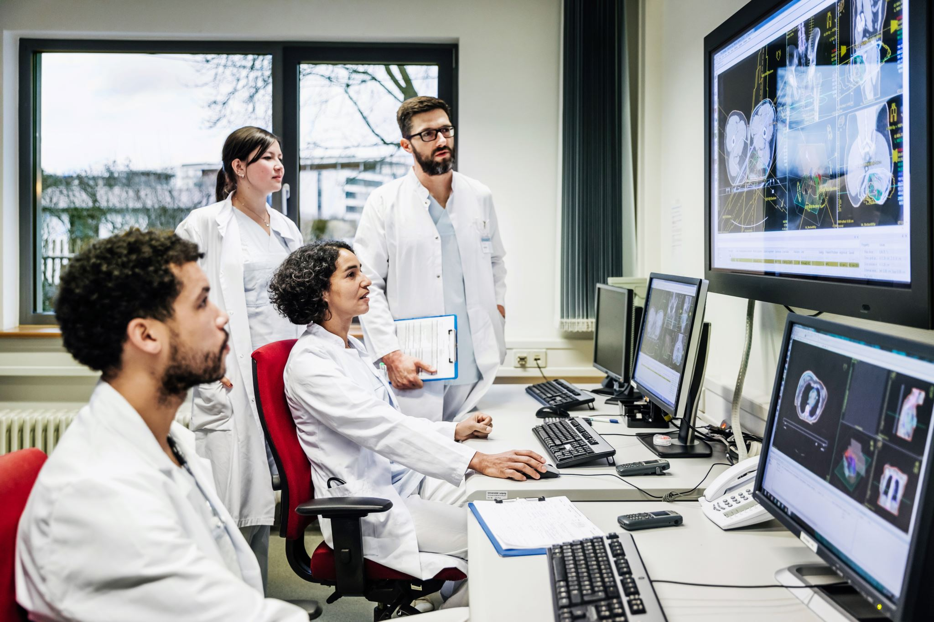


Conclusion
Any Queries

